Slide 1


Diabetes prediction using M.L
Department of Computer Science
University of Kashmir
Supervised by:
Dr. Manzoor Ahmad Chachoo
(Scientist-D)
Presented by:
Syed Farman Ali- 21045110034

Slide 2

What is Diabetes ?
Diabetes is a chronic medical condition that occurs when the body cannot produce enough insulin or effectively use the insulin it produces. Insulin is a hormone that regulates blood sugar (glucose) and allows it to enter cells, providing them with energy.
There are two main types of diabetes:
Type 1 Diabetes: In this type, the immune system mistakenly attacks and destroys the insulin-producing beta cells in the pancreas. People with type 1 diabetes need insulin injections to survive.
Type 2 Diabetes: This is more common and often develops later in life. In type 2 diabetes, the body doesn't use insulin properly, and over time, the pancreas can't produce enough insulin to maintain normal blood sugar levels.
Common symptoms of diabetes include increased thirst, frequent urination, unexplained weight loss, fatigue, and blurred vision. If left untreated, diabetes can lead to serious complications such as heart disease, stroke, kidney disease, and nerve damage.

Slide 3

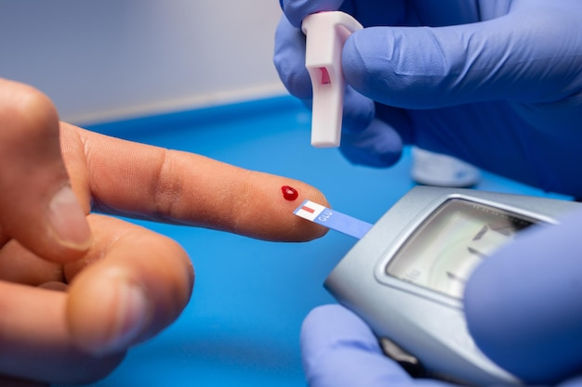

Types Of Diabetes
Type 1 diabetes is characterized by insulin deficiency, while type 2 diabetes involves insulin resistance, and gestational diabetes occurs during pregnancy.
Causes Of Diabetes
The causes of diabetes can vary, including genetic predisposition, lifestyle factors, autoimmune factors, and hormonal changes during pregnancy.
Symptoms Of Diabetes Common symptoms of diabetes include excessive thirst, frequent urination, unexplained weight loss or gain, fatigue, blurred vision, slow-healing wounds, and tingling or numbness in the hands or feet.

Slide 4

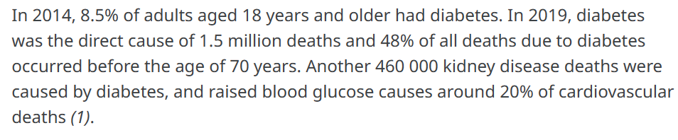
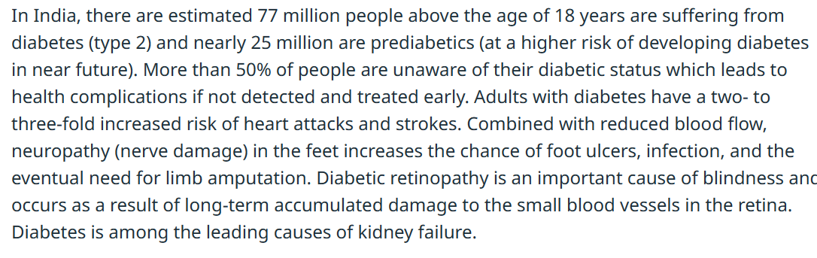

Slide 5
WHY WE NEED DIABETS PRDICTION
Early Detection and Prevention:
Machine learning predicts diabetes risk for early intervention.
Enables timely lifestyle changes and medical treatment.
Personalized Healthcare:
Develops tailored prediction models based on individual health, lifestyle, and genetics.
Guides personalized actions for effective diabetes prevention.
Resource Optimization:
Predictive models help allocate healthcare resources efficiently.
Focuses preventive measures on individuals at higher risk.
Population Health Management:
Informs public health officials about diabetes prevalence in specific demographics.
Guides targeted interventions and resource allocation.
Reducing Healthcare Costs:
Early identification and intervention reduce long-term healthcare costs.
Addresses the significant economic burden of diabetes globally.
Improved Patient Outcomes:
Early intervention improves patient outcomes.
Promotes better health management, delaying diabetes onset.
Technological Advancements:
Wearable devices and continuous monitoring enhance prediction accuracy.
Real-time data collection improves the effectiveness of preventive strategies.
Research and Innovation:
Diabetes prediction research advances machine learning in healthcare.
Innovations applicable to other medical conditions, contributing to public health.

Slide 6

+
+
How do we predict diabetes?
There are two methods to predict diabetes:
Manual by Doctors.
Automated by diabetes prediction and Detection.
+
Approaches in automated predict diabetes :
Random Forest
Decision tree
Support vector machines
+

Slide 7
Modules
Hardware:
I7 processer .
16GB RAM.
Software:
Python.
Vs Code .
Jupyter Notebook.
Djangoo

Slide 8
workflow
Data
Collection
Data
Pre-processing
Feature
Selection and data split
SVM
Model Selections
Random
Forest
Decision tree
Training
Testing
Model
Training
Model
Evaluation
Deployment

Slide 9
DataSet
This dataset is originally from the National Institute of Diabetes and Digestive and Kidney Diseases. The objective of the dataset is to diagnostically predict whether or not a patient has diabetes, based on certain diagnostic measurements included in the dataset. Several constraints were placed on the selection of these instances from a larger database. In particular, all patients here are females at least 21 years old of Pima Indian heritage..
Title: “diabetes predicition ”
Source and Retrieval:
Source: Kaggle.com
Files: “diabetes.csv"
Dataset Details:
Total Records: 2000
Attributes:
Pregnancies
Glucose
BloodPressure
SkinThickness
Insulin
BMI
DiabetesPedigreeFunction
Age
Outcome

Slide 10
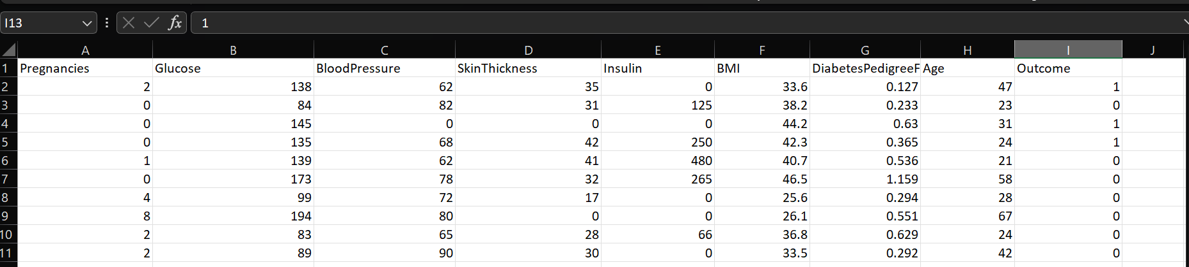

Slide 11
Data preprocessing
Data preprocessing is essential for effective data analysis and machine learning. It encompasses cleaning, transforming, and organizing raw data to create a format suitable for analysis or model training. The objective is to enhance data quality, ensuring it meets the requirements for meaningful analysis and model development..
The main two techniques in our dataset are:
StandardScaler
SimpleImputer

Slide 12
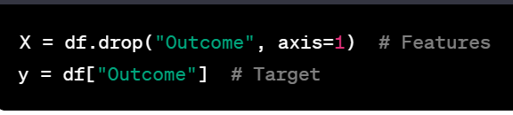
Feature selection
Feature selection is a crucial step in building machine learning models, as it helps improve model performance and reduce overfitting
Break down the dataset into features (X) and the target variable (y).
X: Contains all the features (independent variables) except the "Outcome" column.
y: Represents the target variable, which is the "Outcome" column

Slide 13
Algorithm
Algorithms use in diabetes prediction.
Support vector machine (svm).
Random forest .
Decision Tree.

Slide 14
).
SVM
SVM is a powerful supervised algorithm that works best on smaller datasets but on complex ones. Support Vector Machine, abbreviated as SVM can be used for both regression and classification tasks, but generally, they work best in classification problems
svmclassifier = svm.SVC(kernel='linear')
svmclassifier.fit(x_train, y_train)
Initialization:
A Support Vector Machine (SVM) classifier (svmclassifier) is created for predicting diabetes.
Linear Kernel:
The choice of a linear kernel (kernel='linear') signifies that the SVM aims to find a straight line to separate diabetic and non-diabetic cases.
Model Training:
The model is trained using x_train (input features) and y_train (labels or outcomes

Slide 15
Why Use a Linear Kernel?
Linear Separation:
Diabetes prediction often involves finding linear patterns in data.
A linear kernel is suitable when the relationship between features and outcomes can be represented by a straight line.
Simplicity and Interpretability:
Linear models are simpler and easier to interpret.
They provide a clear understanding of how each feature contributes to the prediction.
Efficiency:
Linear kernels are computationally efficient, making them suitable for large datasets.

Slide 16
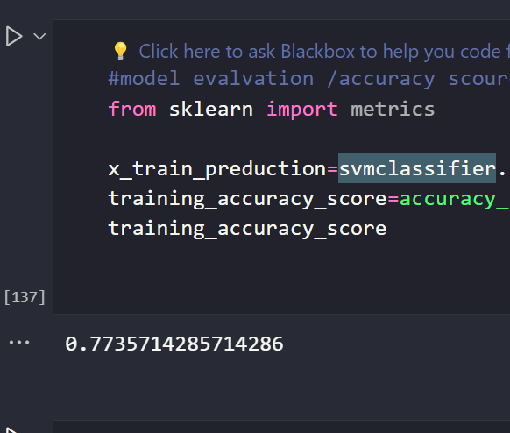
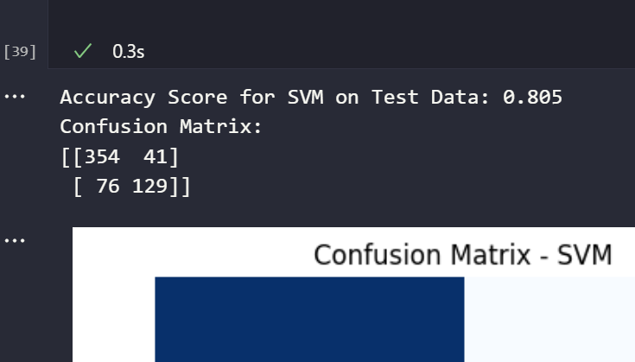
+
+
Result
Our SVM model has achieved a accuracy of 79 -80% .
+
+

Slide 17
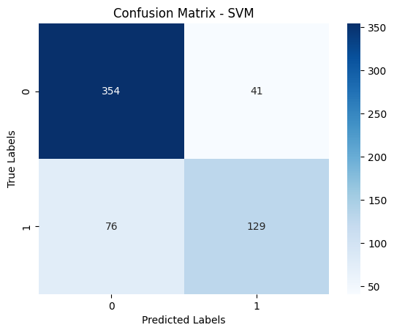

Slide 18
Random forest
Random Forest is a widely-used machine learning algorithm developed by Leo Breiman and Adele Cutler, which combines the output of multiple decision trees to reach a single result. Its ease of use and flexibility have fueled its adoption, as it handles both classification and regression problems.
rfc = RandomForestClassifier(n_estimators =100, criterion = 'entropy', random_state = 0 , max_features = 'auto', max_depth = 10)
rfc.fit(x_train, y_train)

Slide 19
RandomForestClassifier:
RandomForestClassifier is a machine learning model belonging to the ensemble learning category, specifically a random forest for classification tasks.
n_estimators=100:
The parameter n_estimators defines the number of decision trees in the forest.
Setting it to 100 means that the random forest will consist of 100 decision trees.
criterion='entropy':
The criterion parameter determines the function used to measure the quality of a split.
'Entropy' is a measure of impurity; the algorithm aims to reduce entropy in decision tree nodes.
random_state=0:
random_state is a seed for the random number generator.
Setting it to 0 ensures reproducibility, meaning if you run the code multiple times, you'll get the same results.
max_features='auto':
The maximum number of features considered for splitting a node is set to 'auto,' which means it considers all features for each split.
This provides flexibility for the model to find the best features during the learning process.
max_depth=10:
max_depth limits the maximum depth of the decision tree. Here, it's set to 10.
Constraining tree depth helps prevent overfitting and makes the model more interpretable.

Slide 20
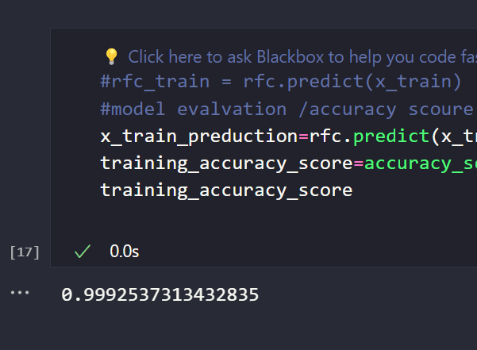
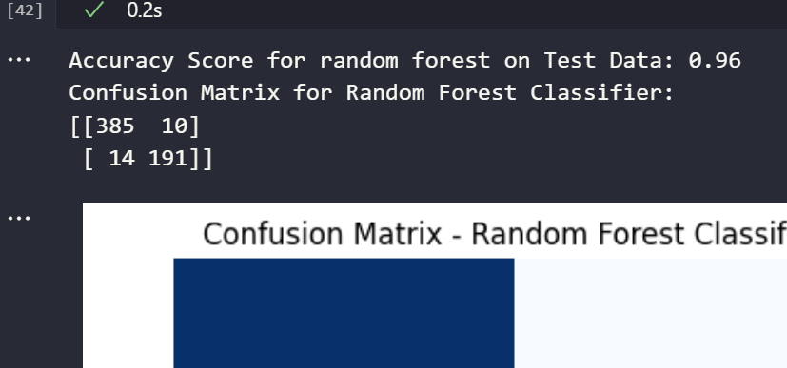
+
+
Result
Our Random forest model has achieved a remarkable accuracy of 96% - 97%.
+
+

Slide 21
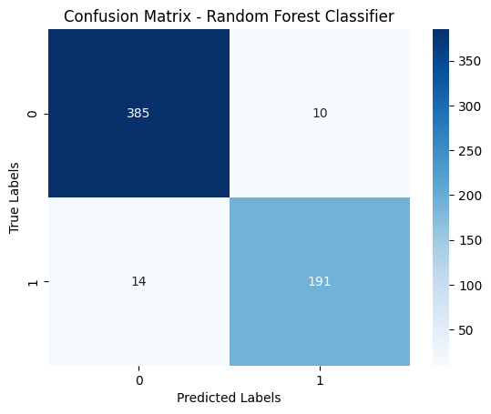

Slide 22
DecisionTreeClassifier:
DecisionTree
A Decision Tree is a predictive model that takes the form of a tree-like structure, consisting of decision nodes and leaf nodes. It is used for both classification and regression tasks in machine learning. The structure of the tree is built by recursively splitting the dataset based on the most significant features, creating a flowchart-like representation of decision-making.
dtree = DecisionTreeClassifier()
dtree.fit(x_train,y_train)
DecisionTreeClassifier:
DecisionTreeClassifier is a machine learning model that belongs to the family of decision tree-based models, specifically designed for classification tasks.
Model Initialization:
dtree = DecisionTreeClassifier(): Creates an instance of the Decision Tree classifier.
Model Training:
dtree.fit(x_train, y_train): Trains the Decision Tree model using the training data (x_train) and corresponding labels (y_train).

Slide 23
DecisionTree
Purpose in Diabetes Prediction:
Decision Tree for Classification:
Decision trees are effective for classification tasks, including predicting the likelihood of diabetes in this case.
Interpretability:
Decision trees are interpretable models, making it easier to understand how the model makes predictions.
Feature Importance:
The Decision Tree algorithm automatically identifies and uses the most important features for making decisions, which can be valuable for understanding the factors influencing diabetes prediction.
Handling Nonlinear Relationships:
Decision trees are capable of capturing nonlinear relationships between features and the target variable, which can be beneficial if the diabetes prediction task involves complex interactions among features.

Slide 24
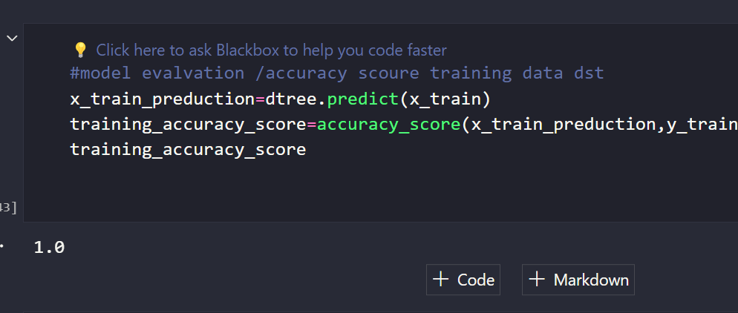
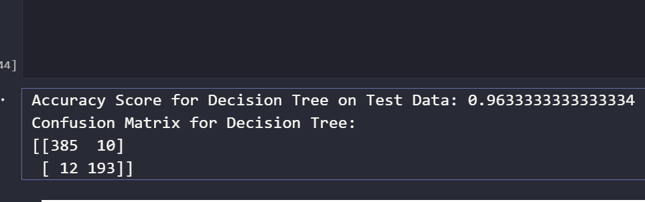
+
+
Result
Our Decision Tree model has achieved a remarkable accuracy of 96.3% - 98%.
+
+

Slide 25
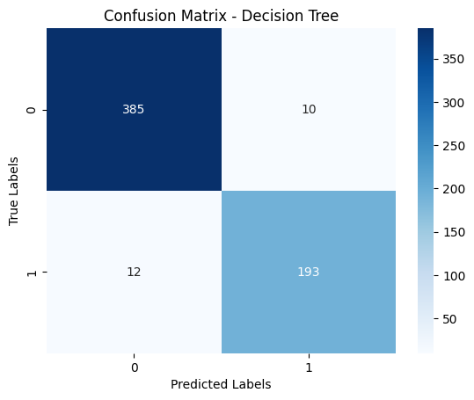

Slide 26
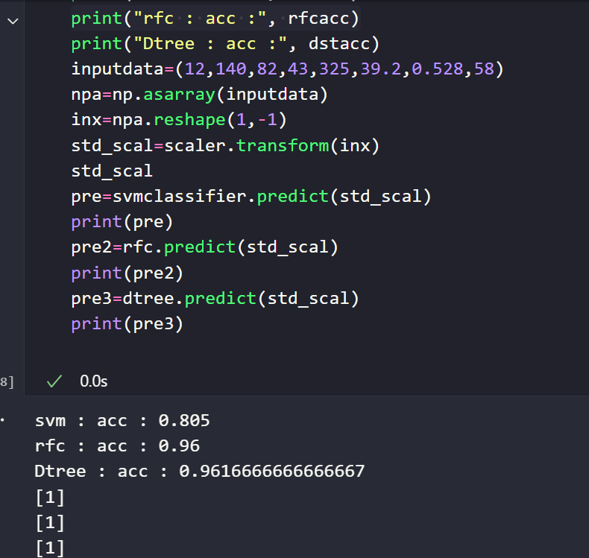

Slide 27
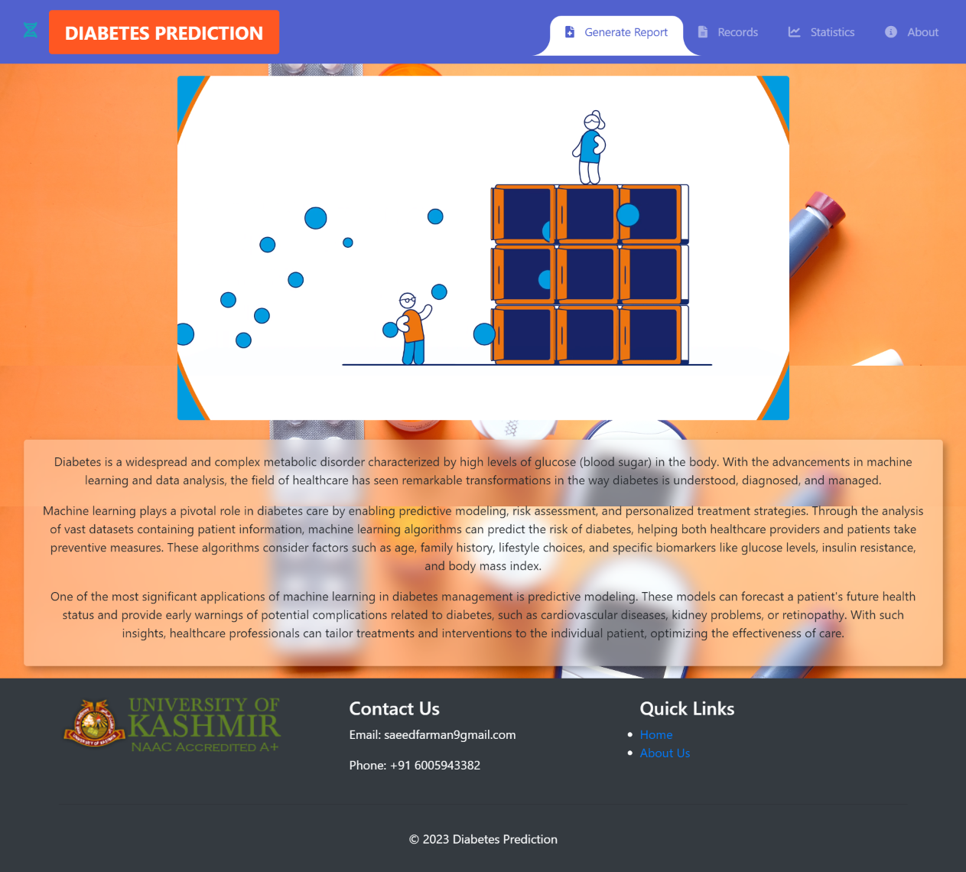
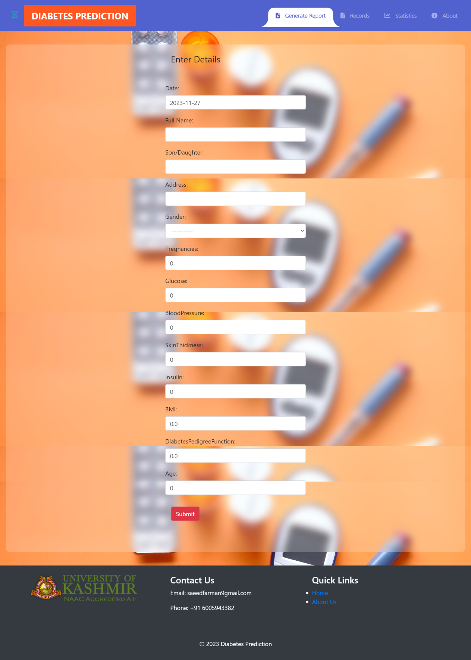
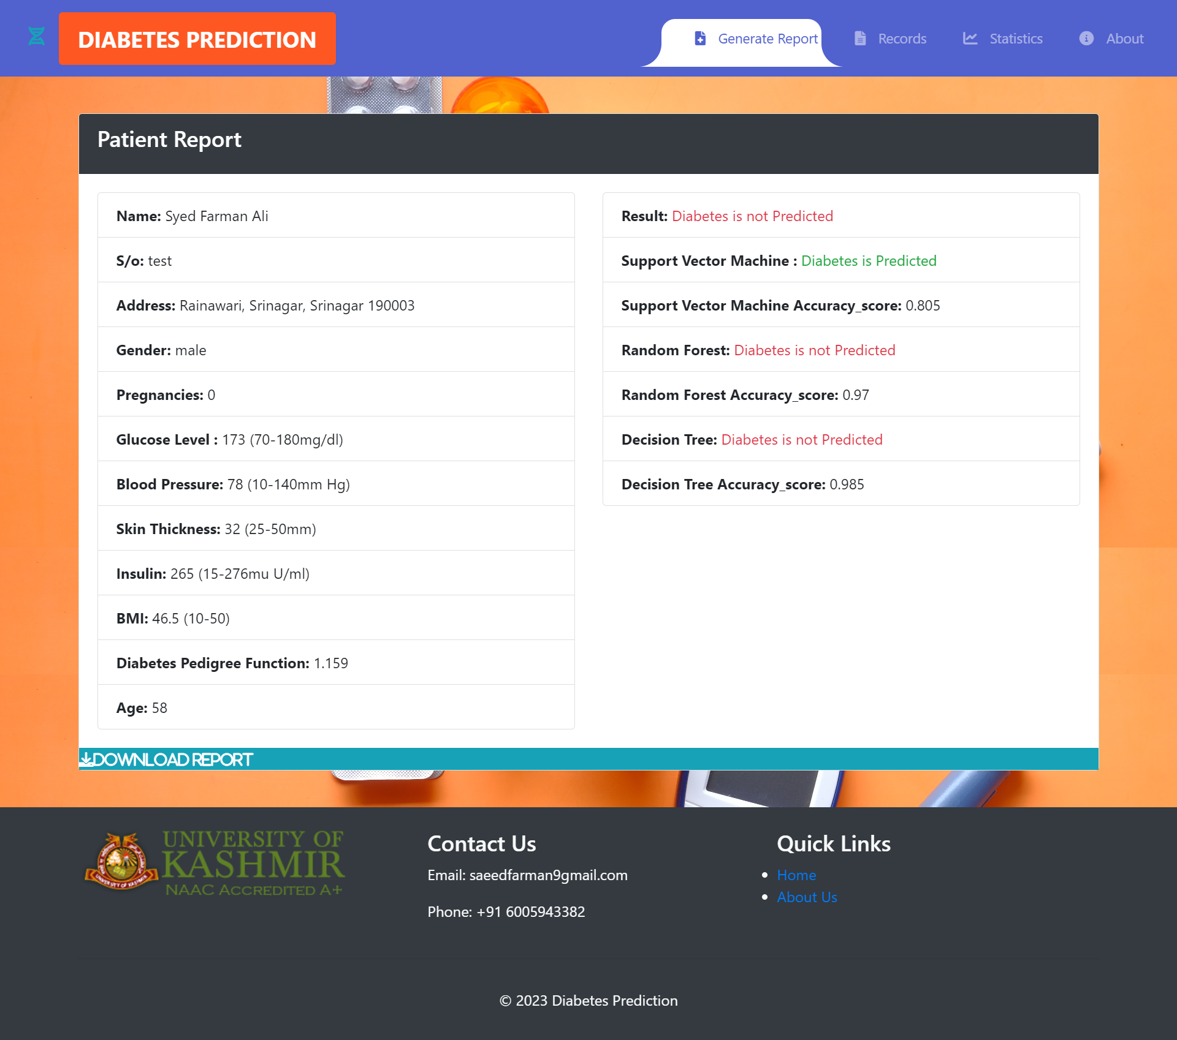
+
Deployment:
Django is a web framework for building web applications using the Python programming language. While Django is not directly used for deploying machine learning models, it can be part of the overall system architecture for deploying a diabetes prediction model.
+
+
+

Slide 28
Build the Diabetes Prediction Model:
Develop and train your diabetes prediction model using a machine learning framework like scikit-learn or TensorFlow..
Create a Django Web Application:
Use Django to create a web application that will serve as the user interface for interacting with the diabetes prediction model.
Incorporate Model in Django Application:
Integrate the serialized machine learning model into your Django application. This can be done by loading the model during the application's initialization or creating an API endpoint to handle model predictions.
User Input Handling:
Use Django's forms or other input handling mechanisms to collect user input, such as relevant health parameters, for making predictions.
Model Inference:
When a user submits input, use the loaded machine learning model to make predictions based on the provided features.
Display Results:
Present the prediction results to the user through the Django web interface.
Deployment:
Deploy the Django web application along with the integrated machine learning model to a web server. This can be done using platforms like Heroku, AWS, or any other suitable hosting service.
Scalability and Optimization:
Optimize the deployment for scalability, security, and performance. Depending on the number of users and the load on the application, you may need to consider scaling strategies and caching mechanisms.

Slide 29
Pages in this web application:
Home:

Slide 30
Pages in this web application:
Generate report :

Slide 31
Pages in this web application:
report page :

Slide 32
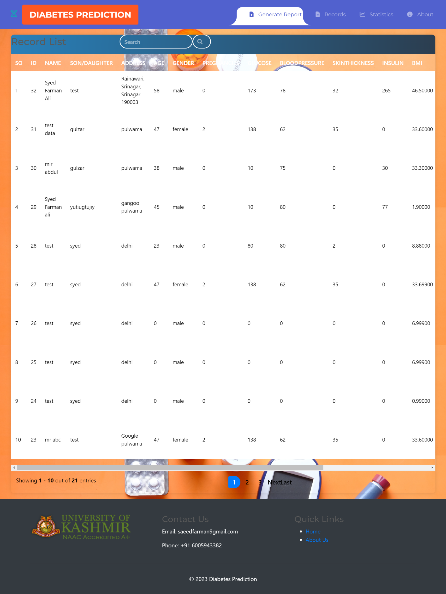
Pages in this web application:
records :

Slide 33
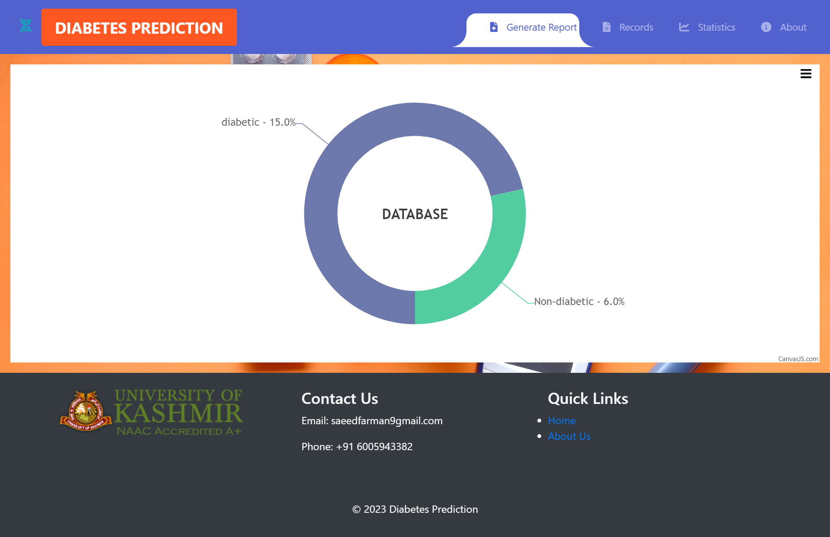
Pages in this web application:
statistics :

Slide 34
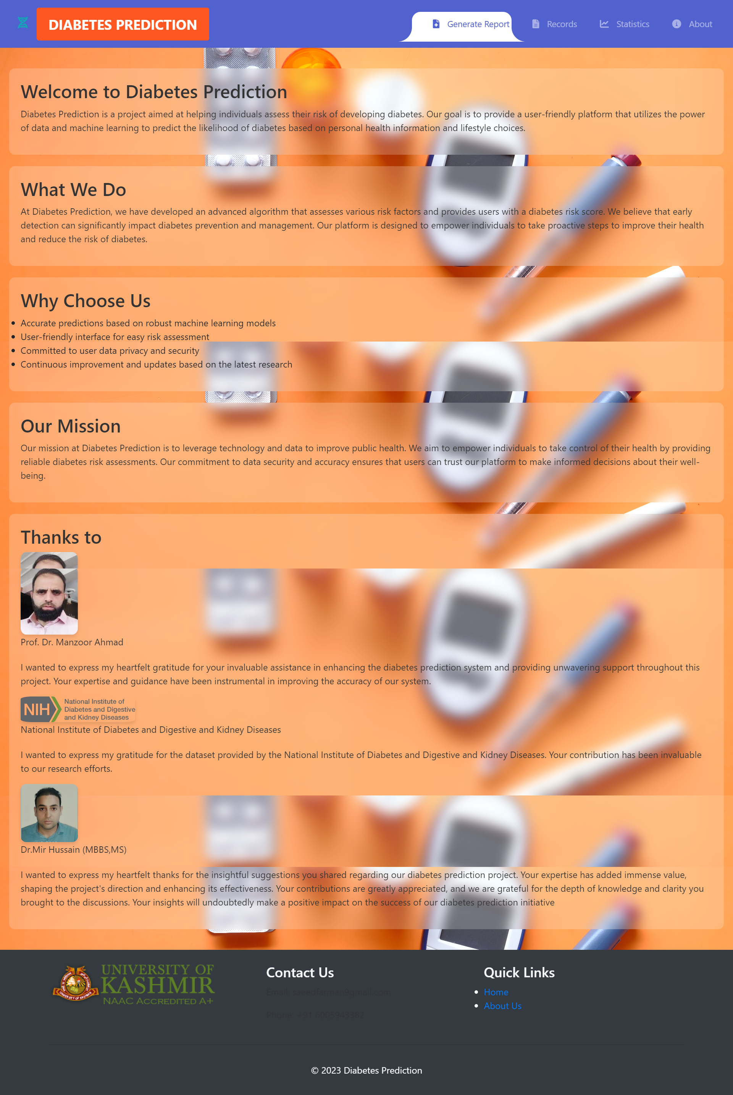
Pages in this web application:
about :

Slide 35
Thank You!

